Slide 1
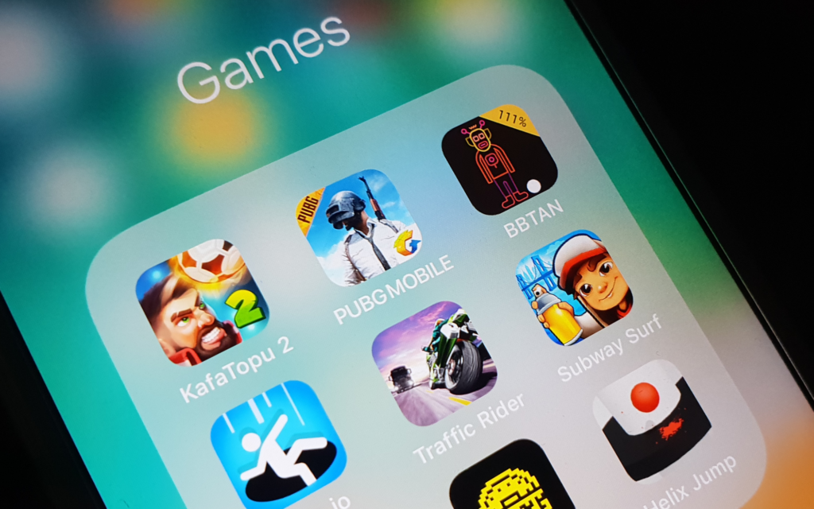
Apple App Store Game Icons linked to User Rating
Team 7
Leona Yiu & Xiaoxu Zhang

Slide 2

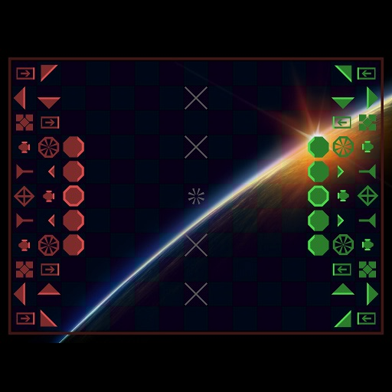



Objective
Can we predict the user rating of a game from the Apple App Store based on the appearance of the game’s icon (512 x 512 pixels)?
Laser Chess
Average User Rating: 1.5
User Rating Count: 200
Tank Ace 1944 HD Lite
Average User Rating: 2
User Rating Count: 697
Morocco
Average User Rating: 3
User Rating Count: 8,376
Kingdom Rush HD
Average User Rating: 5
User Rating Count: 36,212

Slide 3

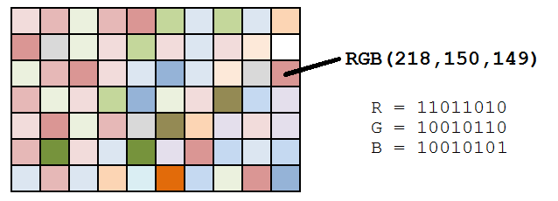
Data Preparation
Data set from Kaggle consists of 17,007 strategy games from Apple App Store collected on August 3rd, 2019
Each game icon jpg (taken from Icon URL) converted into 512 x 512 strings of color code (RGB format)
Based on color codes in icon, 3 features created:
hpercent_c_cnt: count of colors taking >10% of full image
lpercent_c_cnt: count of colors taking <0.1% of the full image
max_c_cnt: count of pixels of the color that appears the most in the icon image
Notes:
The data source was obtained from Kaggle via the following link . The data set comprises 17,007 strategy games available on the Apple App Store and was collected on August 3rd, 2019 using the iTunes API and the App Store sitemap.
17 features in dataset (key ones of interest: Icon URL, Average User Rating, User Rating Count, Game Name)

Slide 4
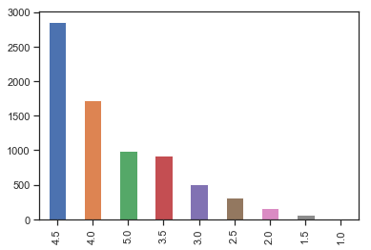
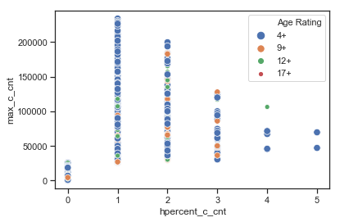
Data Exploration
hpercent_c_cnt | Average User Rating | Count
0 | 4.0 | 676
 | 4.5 | 1,435
 | 5.0 | 206
1 | 4.0 | 153
 | 4.5 | 277
 | 5.0 | 55
2 | 4.0 | 37
 | 4.5 | 91
 | 5.0 | 41
Prelim observation - data set consists heavily of highly rated games (potentially impacting model)
Majority of high rated games have icon images with 0 color taking >10% of full image (hpercent_c_cnt) and <27K pixels of color that appears most in icon (max_c_cnt)

Slide 5
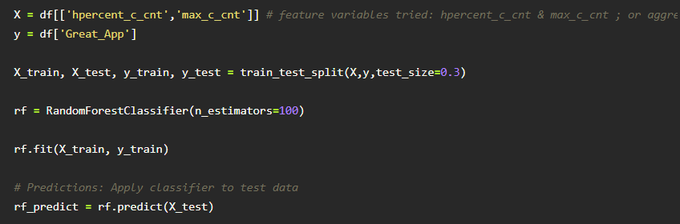
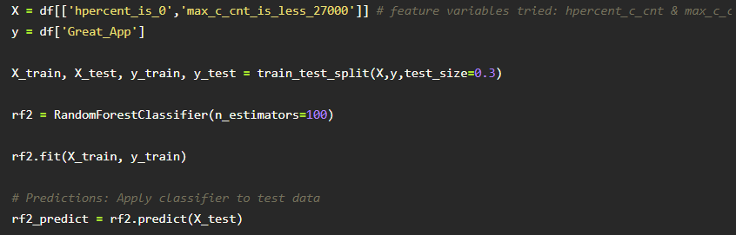
Data Modeling - Random Forest Classifier
Accuracy: 0.63199647
Accuracy (after fine tuning): 0.73336271

Slide 6
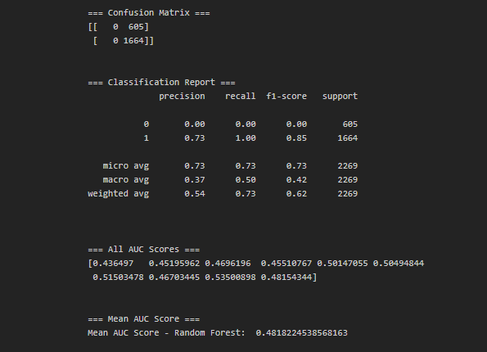
Data Modeling - Random Forest Classifier
Model accurately predicted 73% cases that game is a Great App (rating 4+), 27% incorrectly predicted
73% precision classifying game is a Great App based on feature variables hpercent_is_0 & max_c_cnt_is_less70000; 100% recall
Mean AUC Score of 0.48, however, indicating mediocre classifier to distinguish between highly rated games vs. lower rated games
Notes:
Confusion Matrix Results: Model accurately predicted 1664 / 2269 (73%) cases that the game is a Great App (high rating of 4 or higher). However, there are 605 cases (25%) cases where the model incorrectly predicted that the game is a Great App, when based on the actual average user ratings from the data set, the games had low ratings.
Classification Report Results: 73% precision classifying that a game is a Great App based on feature variables hpercent_is_0 and max_c_cnt_is_less_27000 (0 color taking >10% of game icon, <27,000 pixels of the most frequent color present in icon). 100% recall indicating 100% of all the game icons with high rating were correctly labled by the Random Forest classifier. F1 score of 85%, measuring test's accuracy as weighted harmonic mean of precision and recall. Overall, the Random Forest Classifer is good at recognizing game with high rating.
Mean AUC Score: Mean AUC score value of 0.48 indicates a mediocre classifier, being able to distinguish between highly rated games versus low rated games.

Slide 7


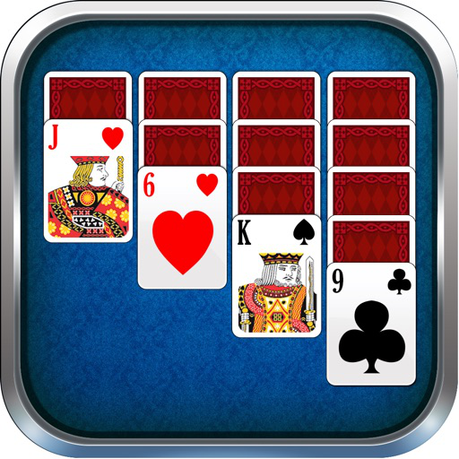
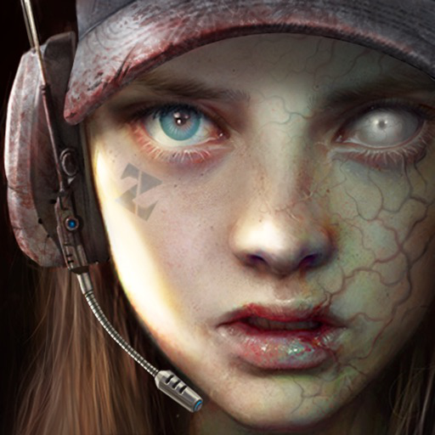
Results - Classified High Rated Games vs Actual Rating
Logic Puzzles+
Average User Rating: 5
User Rating Count: 50
Hpercent_c_cnt: 0
max_c_cnt: 17,388
Land Air Sea Warfare HD RTS
Average User Rating: 4
User Rating Count: 660
Hpercent_c_cnt: 0
max_c_cnt: 518
Solitaire 2017 HD
Average User Rating: 4
User Rating Count: 241
Hpercent_c_cnt: 0
max_c_cnt: 9,790
Age of Z
Average User Rating: 4.5
User Rating Count: 3,553
Hpercent_c_cnt: 0
max_c_cnt: 814

